Slide 1
Unit 5 – File Management

Slide 2
OS in File Management
The operating system is responsible for the following activities in connection with file management:
The creation and deletion of files.
The creation and deletion of directory.
The support of primitives for manipulating files and directories.
The mapping of files onto disk storage.
Backup of files on stable (non volatile) storage.

Slide 3
Introduction
File is a collection of related information defined by user or creator
Stored on the secondary storage device .i.e. disks or tape
Commonly file represent programs (both source and object forms) and data
Data files may be numeric, alphabetic or alphanumeric
Files may be free-form, such as text files, or may be rigidly formatted

Slide 4
File Attributes
Name – only information kept in human-readable form
Identifier – unique tag (number) identifies file within file system
Type – needed for systems that support different types
Location – pointer to file location on device
Size – current file size
Protection – controls who can do reading, writing, executing
Time, date, and user identification – data for protection, security, and usage monitoring
Information about files are kept in the directory structure, which is maintained on the disk
Many variations, including extended file attributes such as file checksum
Information kept in the directory structure

Slide 5
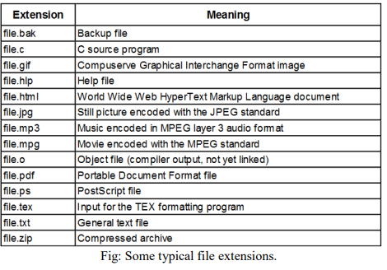
File Naming

Slide 6
File Structure
Three common possibilities or ways to struct files:
Unstructured
Record Structure
Tree Structure

Slide 7

Unstructured File Structure
Consist of unstructured sequence of bytes or words
OS does not know or care what is in the file
Any meaning must be imposed by user level programs
Provides maximum flexibility
User can put anything they want and name them, anyway that is convenient
Both Unix and Windows use these approach

Slide 8
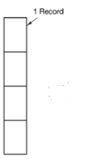
Record Structure
A file is a sequence of fixed-length records, each with some internal structure
Each read operation returns one records, and write operation overwrites or append one record
Many old mainframe systems use this structure

Slide 9
Tree Structure
File consists of tree of records, not necessarily all the same length
Each containing a key field in a fixed position in the record, sorted on the key to allow the rapid searching
The operation is to get the record with the specific key
Used in large mainframe for commercial data processing

Slide 10
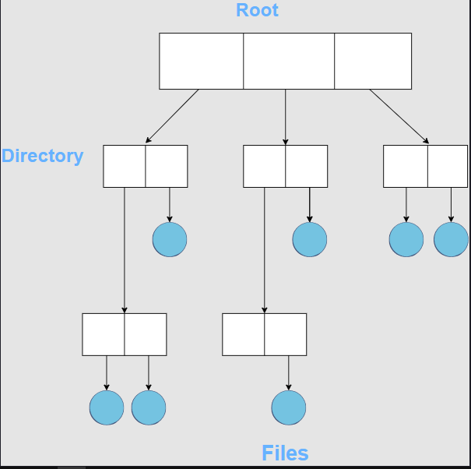

Slide 11
File Types
Regular Files
Contains user information. Generally in ASCII or binary form
Directories
System Files for maintaining the structure of file system
Character Special File
Related to I/O of computer to model serial I/O device such as terminal
ASCII files
Consist of line of text. They can be edited and printed with ordinary file editor
Binary Files
Consist of sequence of bytes only

Slide 12
File Access
Sequential Access
Early operating systems provided only one kind of file access
A process could read all the bytes or records in a file in order, starting at the beginning, but could not skip around and read them out of order
Sequential files could be rewound, however, so they could be read as often as needed
Sequential files were convenient when the storage medium was magnetic tape, rather than disk

Slide 13
File Access (contd.)
Random / Direct Access File
When disks came into use for storing files, it became possible to read the bytes or records of a file out of order, or to access records by key, rather than by position
Files whose bytes or records can be read in any order are called random access files
Essential for many applications, for example, database systems
In some older mainframe operating systems, files are classified as being either sequential or random access at the time they are created.
Modern operating systems do not make this distinction.
All their files are automatically random access

Slide 14
File Operations
Create
Delete
Open
Close
Read
Write
Append
Rename
Seek
Get Attribute
Set Attribute

Slide 15
Directories
Single-Level Directory System
Also called root directory
Two-level Directory System
Hierarchical Directory System

Slide 16
File System Layout
Boot Block
The boot block is available to start the operating system.
Superblock
The super-block maintains information about the entire file system and includes the following fields:
Size of the file system
Number of data blocks in the file system
A flag indicating the state of the file system
Allocation group sizes

Slide 17
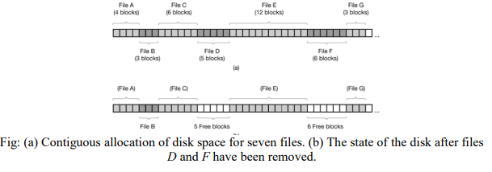
Contiguous Allocation

Slide 18
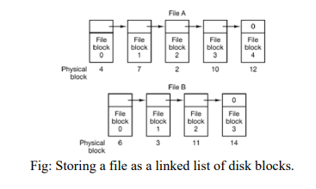
Linked List Allocation

Slide 19
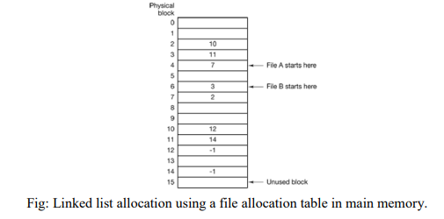
Linked List Allocation using FAT

Slide 20
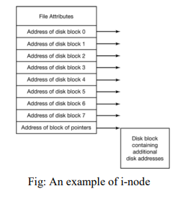
I-node Allocation

Slide 21
Directory Operations
Create
Delete
Opendir
Closedir
Rename
Link
Unlink
Readdir

Slide 22
Path Names
Absolute
Path name starting from root directory to the file
e.g. In Unix: /usr/user1/bin/lab2
E.g. In Windows: C:\Users\Ananta\Teaching_Materials\3rdSem\OS\Lecture_Slides
path separated by / in Unix and \ in windows
Relative
A user can designate one directory as the current working directory
All path names not beginning at the root directory are taken relative to the working directory
E.g., bin/lab2 is enough to locate same file if current working directory is /usr/user1

Slide 23
Directory Implementation
Linear List
Use the linear list of the file names with pointer to the data blocks
It requires linear search to find a particular entry
Advantages: Simple to implement
Problem:
when a file is removed, a variable-sized gap is introduced
Next file to be entered may not fit
But compacting the directory is feasible because it is entirely in memory
single directory entry may span multiple pages, so a page fault may occur while reading a file name

Slide 24
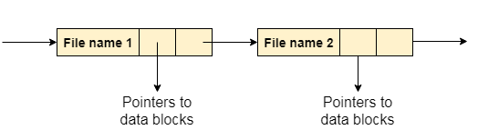
Linear List (contd.)

Slide 25
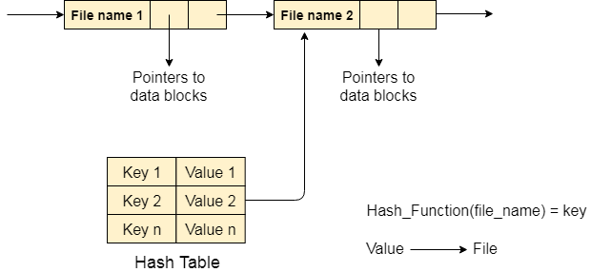
Directory Implementation (contd.)
Hash Table
It consist linear list with hash table
Advantages: greatly decrease the file search time

Slide 26
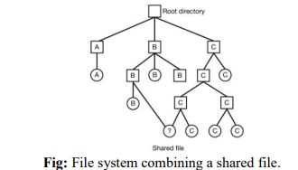
Shared Files
When several users are working together on a project, they often need to share files

Slide 27
Free Space Management
System keeps track of the free disk blocks for allocating space to files when they are created
Also to reuse the space released from deleting the files
The system maintains the free space lists
Free space lists are implemented mainly by
Bitmaps and
Linked Lists

Slide 28
Bitmap or Bit-vector
Each block is represented by a bit
If the block is free, the bit is 1; if the block is allocated the bit is 0
A disk with n blocks requires a bitmap with n bits
Example: Consider a disk where blocks 2,3,4,5,8,9,10,11,12,13,17,18…are free, and rest are allocated
The free space bit map would be 0011110011111100010.........
Advantages: Simple and efficient in finding first free block, or n consecutive free blocks
Problems: Inefficient unless the entire bitmap is kept in main memory

Slide 29

Linked List
Free disk blocks are linked together
Keeping a pointer to the first free block in a special location on the disk and caching it in memory
The first block contains a pointer to the next free block
Advantages: Only one block is kept in memory
Problems: Not efficient; to traverse list, it must read each block

